Slide 1
Monster Makey
By: Jasmine Roach, Kevin Rudio, Sam Downs

Slide 2
Main Idea
Have 3 to 5 premade short halloween based story for people to pick from
Have a demo or small slides about how to change voices
One group can do sounds and another group can make monster out of the playdoh
Show how to add the sounds to the makey makey

Slide 3
Learning Objectives
How to use different applications for sound and recording
How to manipulate and edit sounds and audio
The process of recording and sampling sounds
How to integrate sound recordings into a Makey Makey

Slide 4
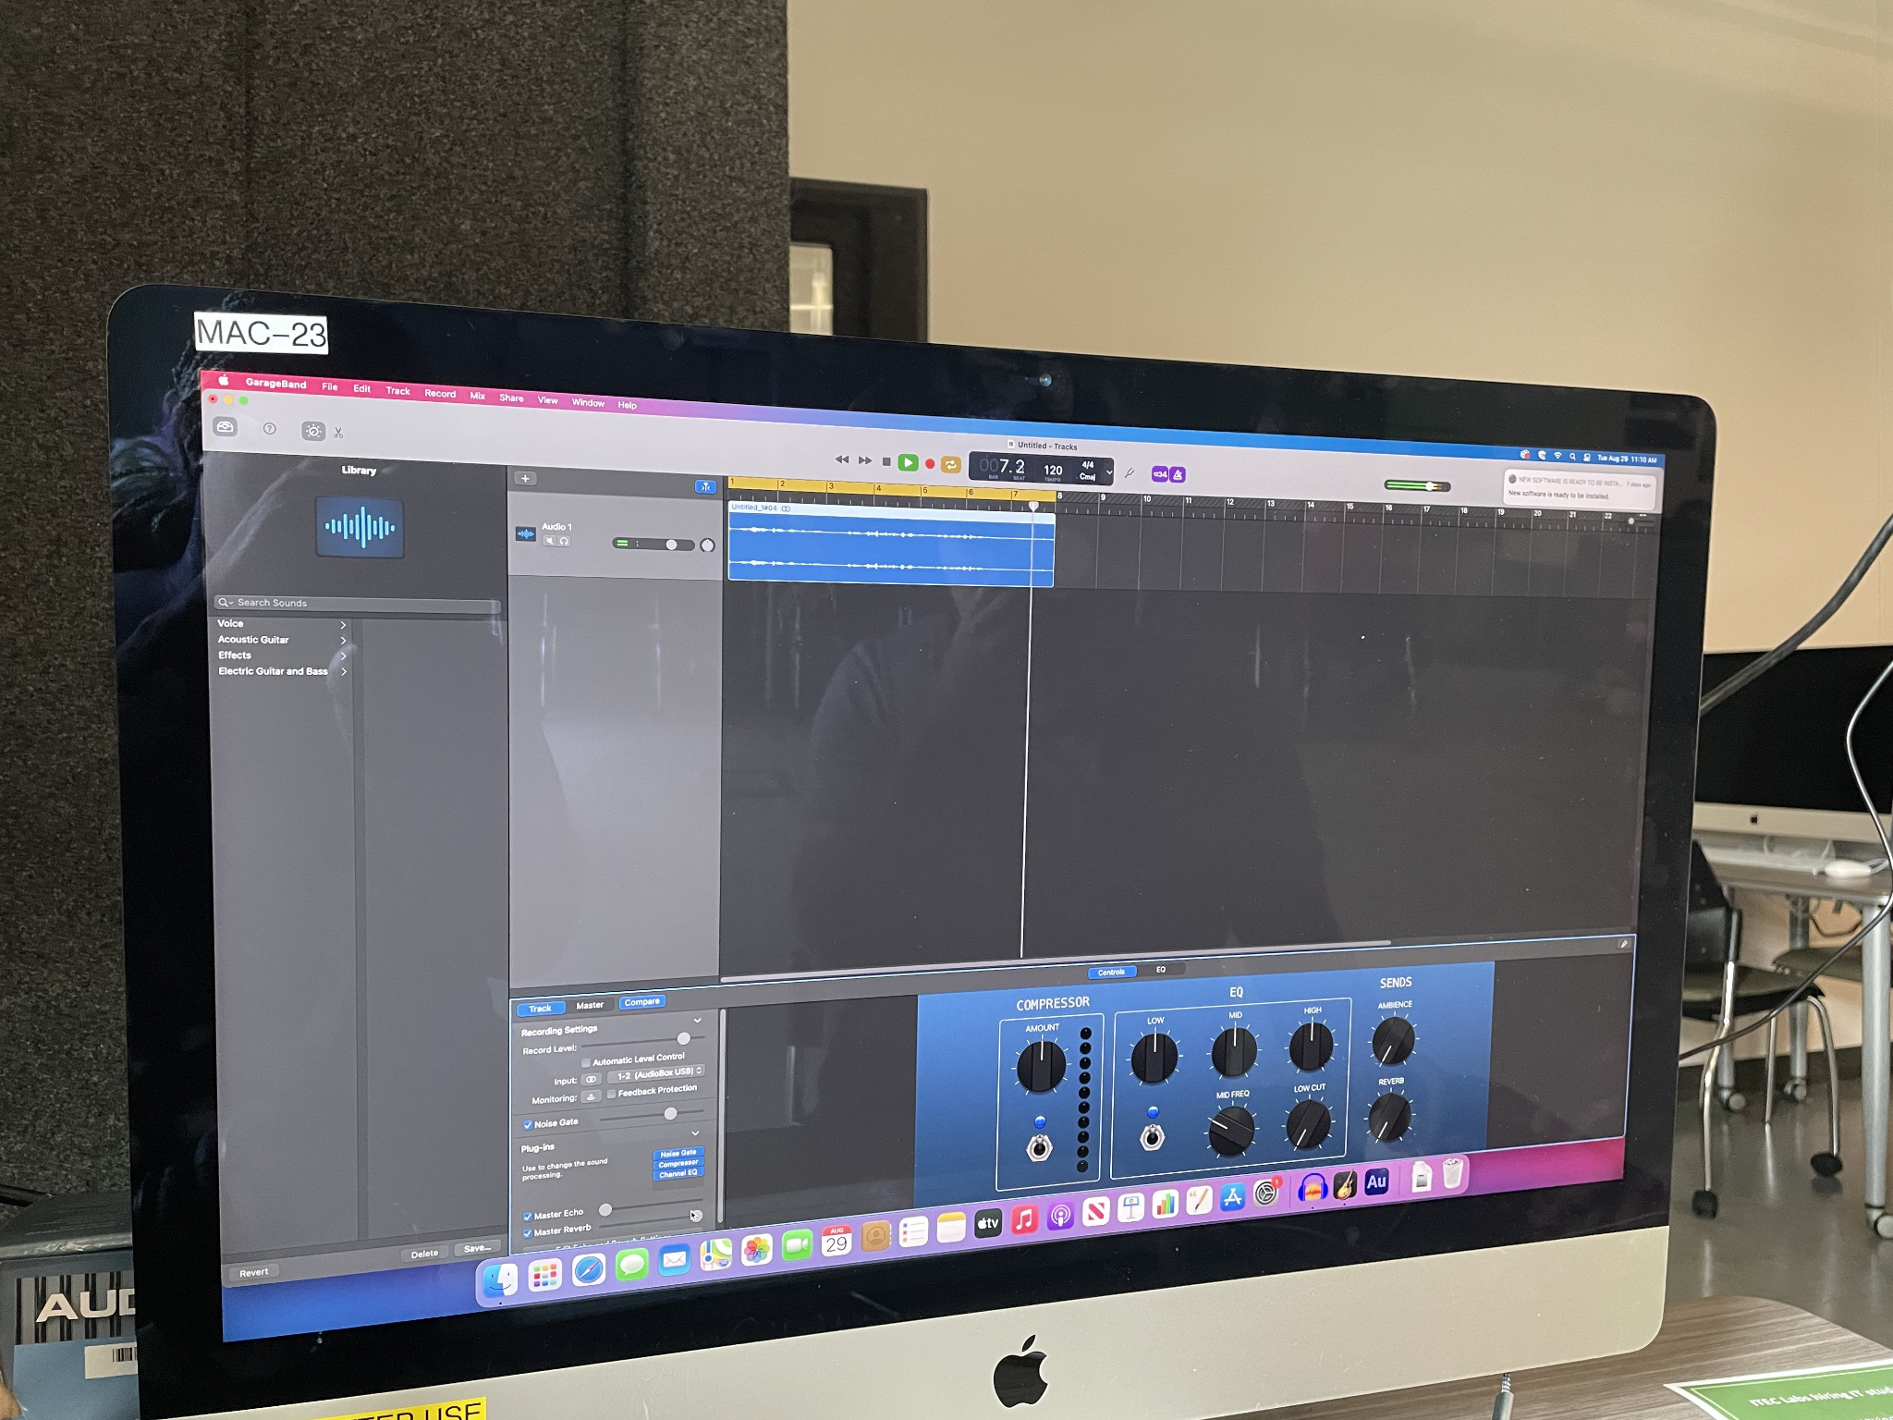
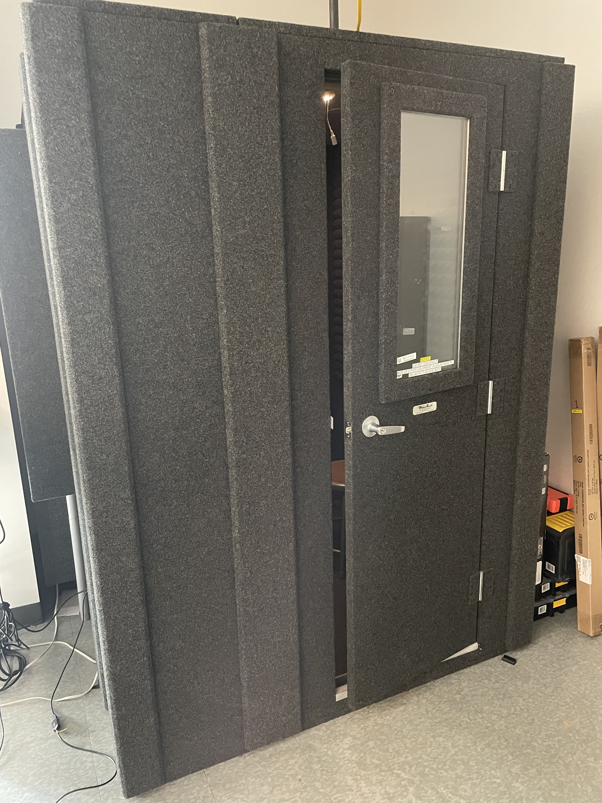
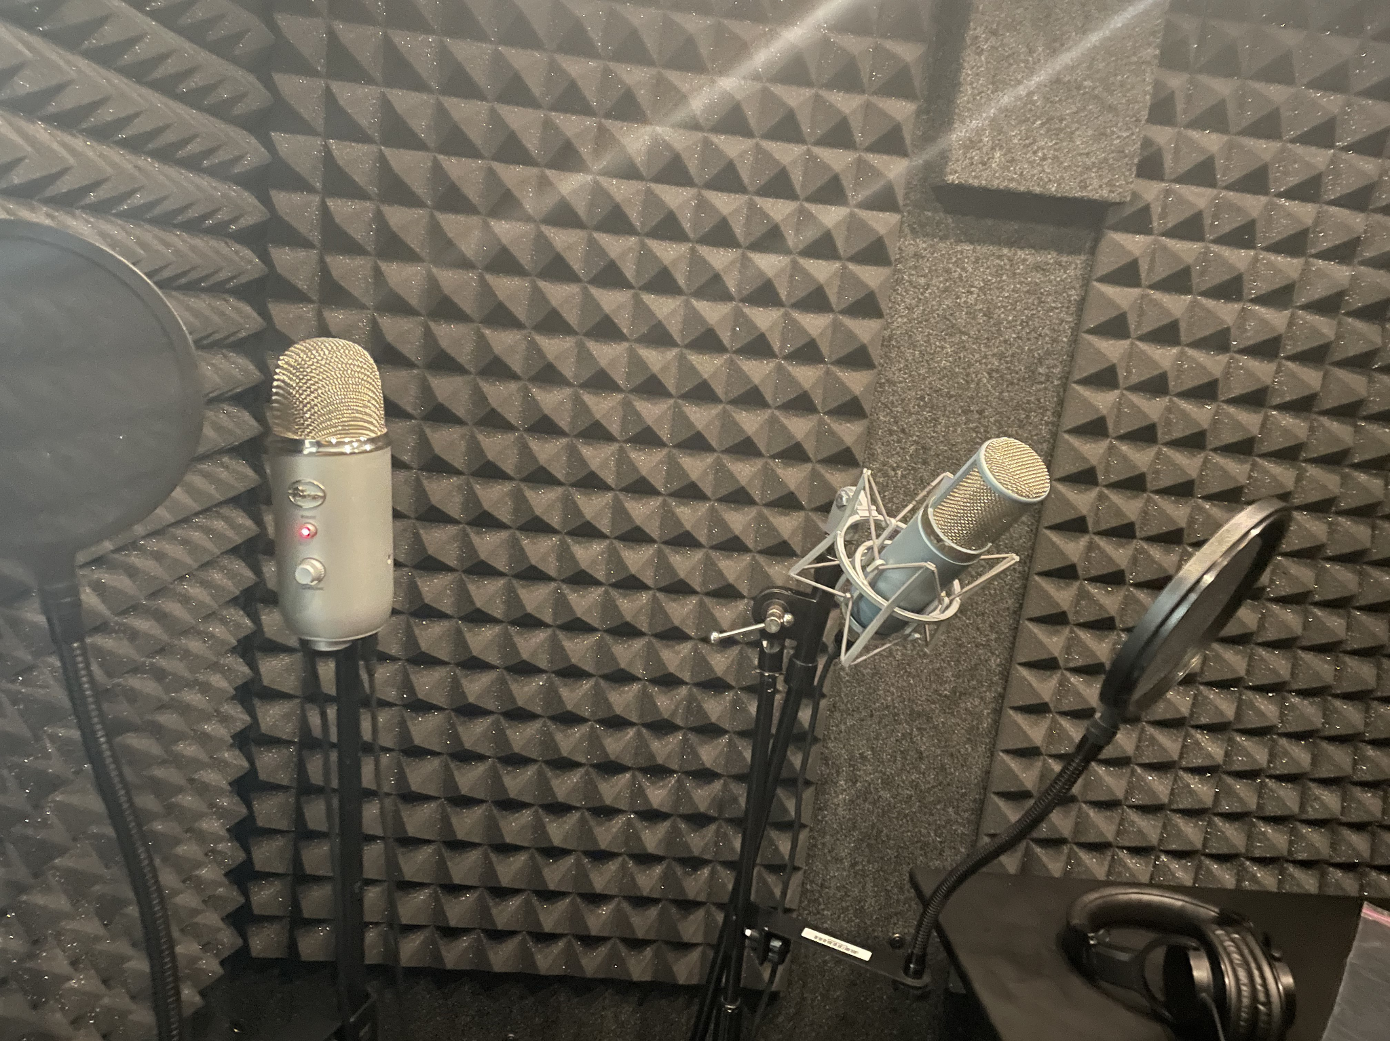

Sound Lab
Recording sound in the sound box
Messing around with the recorded sound using GarageBand

Slide 5
Story Idea
Hallow Fest: short story about a pumpkin head man trying to catch a group of kids during a halloween fest
Witch Maze: Short story about escaping a witches maze
Ghost Haunt: Short story about being trapped inside a haunted house
Zombie Escape: Short story about escaping zombies
Wolf Attack: Short story about fighting against werewolf

